Slide 1
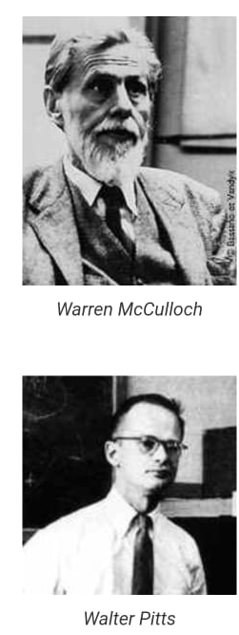


Neural Networks
Session 1 - Introduction & McCulloch-Pitts networks

Slide 2
Introduction
In 1943 when Warren McCulloch, a neurophysiologist, and a young mathematician Walter Pitts, wrote a paper on how neurons might work. They modeled a simple neural network with electrical circuits.
The first artificial neural network (Perceptron) was invented in 1958 by psychologist Frank Rosenblatt.
Reference Book: S. Haykin, "Neural networks and learning machines," Pearson, 2009

Slide 3
Applications
Neural networks are best at identifying patterns or trends in data, they are well suited for prediction or forecasting need including
Sales Forecasting
Customer Research
Data Validation
Risk Management
Target Marketing
Financial Analysis
Industrial Process Control
In other fields:
Real Time translation – Capturing Russian language name boards and translating them into English language.
Medical Field for recognizing diseases
Facial Recognition
Voice Recognition
Music composition
Foreign exchange trading systems
Portfolio selection and management
Forecasting weather patterns
Credit card fraud detection
Signature Verification Application

Slide 4
What Companies use ANN?
Linkedin – for instance, uses neural networks along with linear text classifiers to detect spam or abusive content in its feeds – Deepak Agarwal, Linkedin’s vice president of Artificial Intelligence
Dialog Tech – uses neural networks to classify inbounds calls into predetermined categories or to assign a lead quality score to calls – Hoolihan
Even Google, Microsoft and Amazon investing more in neural networks to solve various business problems said by Nir Bar-Lev, co-founder and CEO of deep learning Platform.

Slide 5
History
In 1943 when Warren McCulloch, a neurophysiologist, and a young mathematician, walter Pitts, wrote a paper on how neurons might work. They modeled a simple neural network with electrical circuits.
Reinforcing this concept of neurons and how they work was a book written by Donald Hebb.
In 1950’s Nathanial Rochester from the IBM research laboratories led the first effort to simulate a neural network. His first attempt failed. But later attempts were successful.
In 1956, Dartmouth Summer research project on AI provided a boost to both AI and Neural Networks.
In continuation with Dartmouth, John Von Neumann suggested imitating simple neuron functions by using telegraph relays or vacuum tubes. Also. Frank Rosenblatt, a neuro-biologist of cornell, began work on the perceptron
A single layer perceptron was found to be useful in classifying a continuous-valued set of inputs into one of two classes.
The perceptron computes a weighted sum of the inputs, subtracts a threshold, and passes one of two possible values out as the result.
In 1959, Bernard widrow and Marchian Hoff of Stanford developed models they called ADALINE and MADALINE. These models were named for their use of multiple adaptive linear elements. MADALINE was the first neural network to be applied to a real world problem. It is an adaptive filter which eliminates echoes on phone lines. This neural network is still in commercial use.
Asimov’s series on robots revealed the effects on man’s morals and values when machines where capable of doing all of mankind’s work. Other writers created more sinister computers, such as HAL from the movie 2001.
These fears, combined with unfulfilled, outrageous claims, caused respected voices to critique the neural network research. The result was to halt much of the funding. This period of stunted growth lasted through 1981.
Because of John Hopfield of Caltech presented a paper to the national academy of sciences stated that not to simply model brains but to create useful devices with clarity and mathematical analysis in 1982 make others to show more interest on neural networks.
In 1987, the IEEE first international conference on Neural Networks drew more than 1800 attendees.
By 1989 at the neural networks for defence meeting Bernard widrow told his audience that they were engaged in world war IV, “World War III never happened,” where the battle fields are world trade and manufacturing.
The 1990 US Department of Defence Small business innovation research program
In 2000- till date Deep learning came plays a vital role in various fields such as NLP, Data analytics etc.

Slide 6
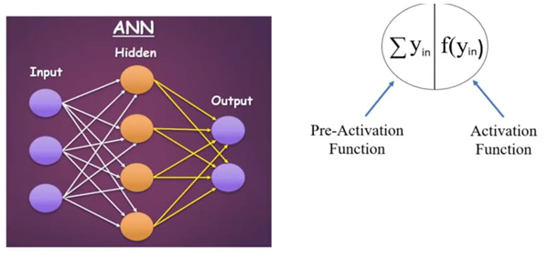
What is Neural Network?
A Neural Network is a series of algorithms that endeavors to recognize underlying relationships in a set of data through a process that mimics the way the human brain operates. In this sense, neural networks refer to systems of neurons, either organic or artificial in nature.
The difference Between neural network and deep learning is that deep learning is the act of using a subset of neural networks called deep neural network.
When the datasets become exceedingly large, deep learning is advantageous because it can process more information and more complex information quickly and accurately

Slide 7
Why Artificial Neural Networks?
As a child, we used to learn the things with the help of our elders, with includes our parents or teachers. Then later by self-learning practice we keep learning throughout our life. Scientists and researchers are also making the machine intelligence, just like a human being, and ANN plays a very important role in the same due to the following reasons-
With the help of neural networks, we can find the solution of such problems for which algorithmic method is expensive so does not exist.
Neural networks can learn by example, hence we do not need to program it at much extent.
Neural Networks have the accuracy and significantly fast speed than conventional speed.

Slide 8
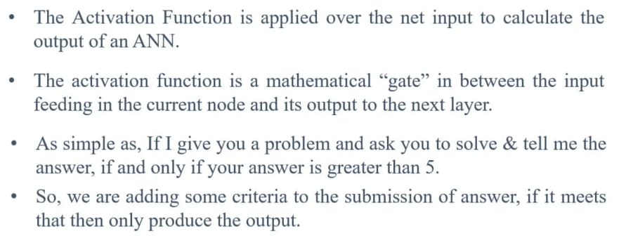
What is Activation Function

Slide 9
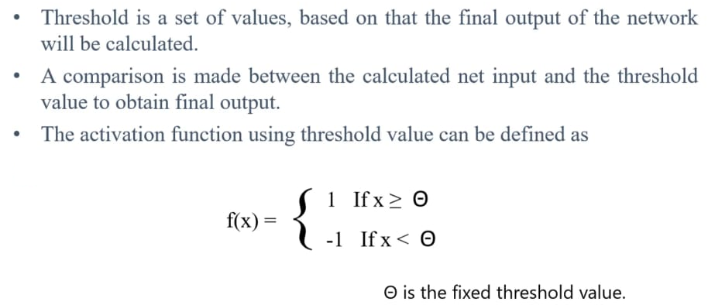
What is Threshold?

Slide 10
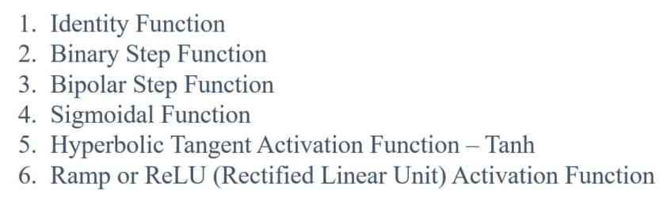
Types of Activation functions

Slide 11
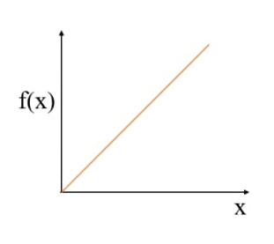
Identity Function
F(x) = x for all x
The output remains same as the input. It is a linear activation function

Slide 12
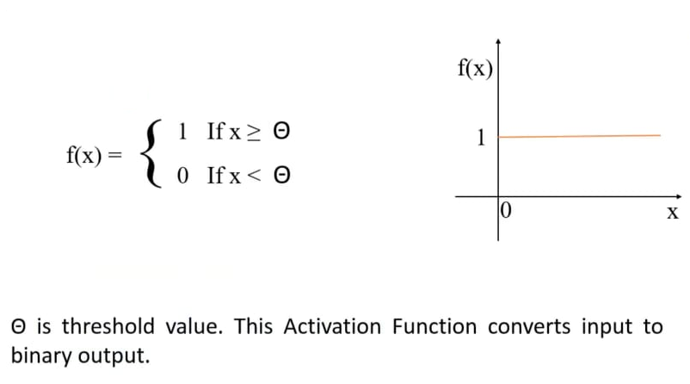
Binary Step Function

Slide 13
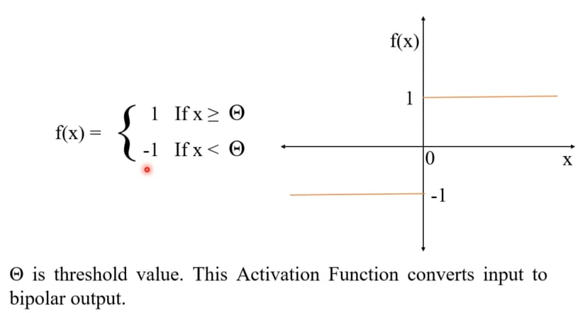
Bipolar Step Function

Slide 14
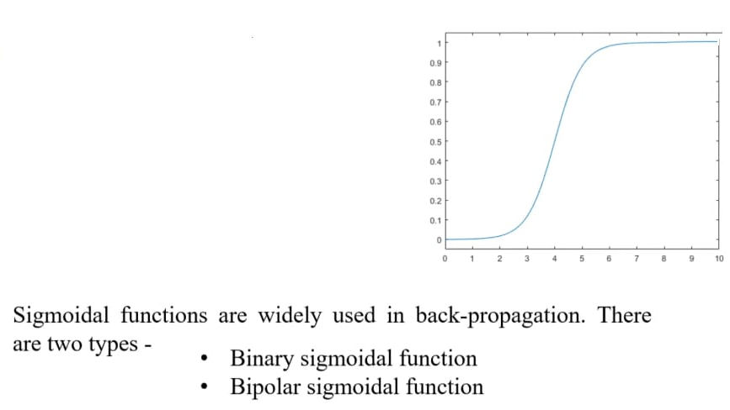
Sigmoid Function

Slide 15
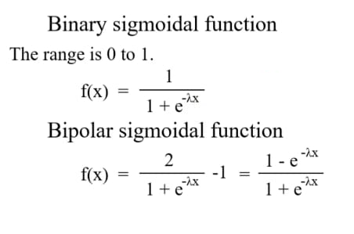
Binary & Bipolar Sigmoid Function

Slide 16
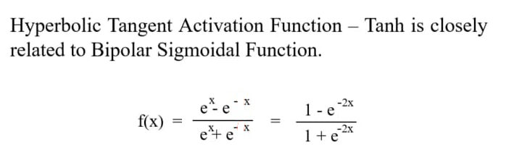
Hyperbolic Tangent Activation Function- Tanh

Slide 17
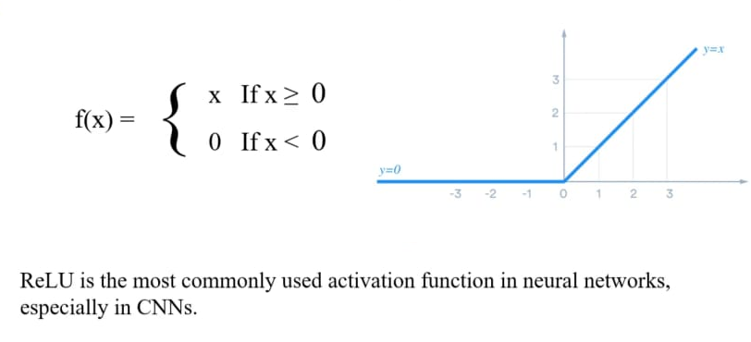
ReLU (Rectified Linear Unit) Activation Function

Slide 18
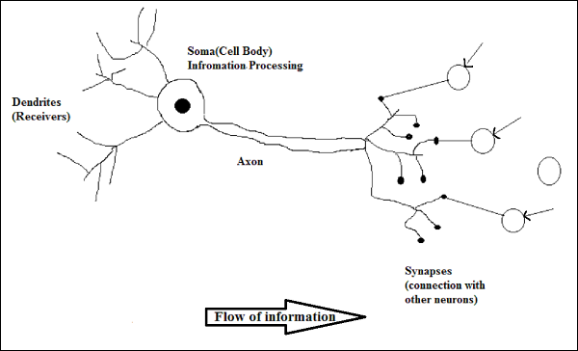
Biological Neuron
A nerve cell neuron is a special biological cell that processes information. Approximately 10¹⁵ interconnected neurons in our body.
Dendrites (in ANN Node): They are tree like branches, responsible for receiving the information from other neurons it is connected to.
Soma (in ANN Input) – It is the cell body of the neuron and is responsible for processing of information, they have received from dendrites.
Axon (in ANN Output) – It is just like a cable through with neurons send the information.
Synapses(in ANN Weights or Interconnections)- it is the connection between the axon and other neuron dendrites.

Slide 19
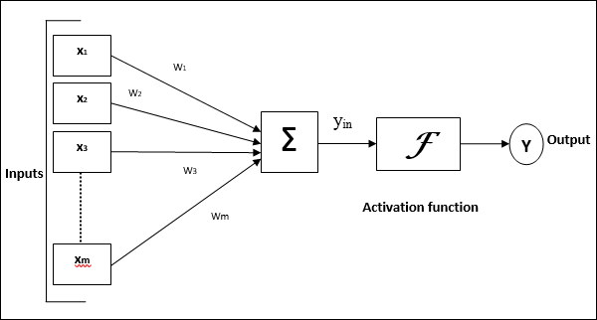
Artificial Neural Network Model
Artificial Neural Networks is also known as Parallel Distributed Processing Systems or Connectionist Systems.
ANN acquires a large collection of units that are interconnected in some pattern to allow communication between the units. These units also referred to as nodes or neurons.
Every neuron is connected with other neuron through a connection link.
Each connection link is associated with a weight that has information about the input signal.
This is the most useful information for neurons to solve a particular problem because the weight usually excites or inhibits the signal that is being communicated.
Each neuron has an internal state, which is called an activation signal.
Output signals, which are produced after combining the input signals and activation rule, may be sent to other units.

Slide 20
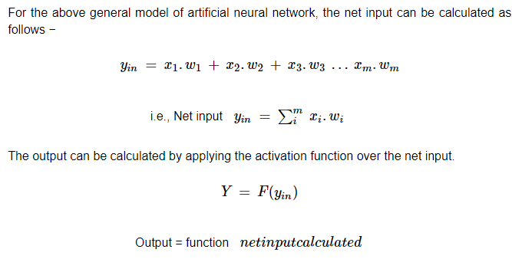
Calculation

Slide 21
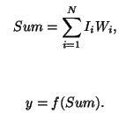
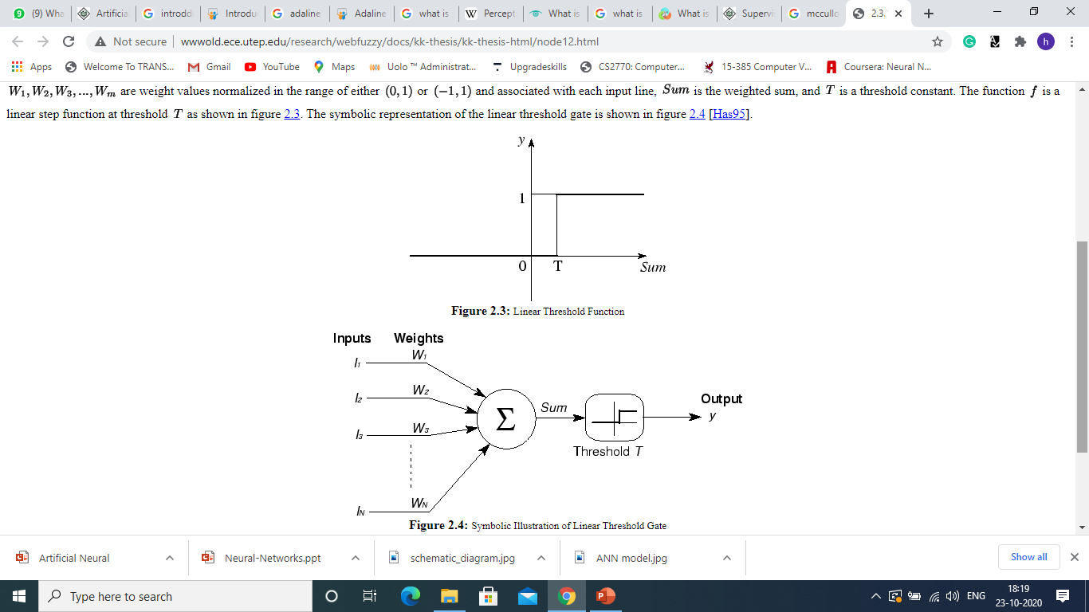
McCulloch-Pitts Model of Neuron
The early model of an artificial neuron is introduced by Warren McCulloch and Walter Pitts in 1943
The McCulloch-Pitts neural models is also know as linear threshold gate. It is a neuron of a set of inputs I1, I2,I3….Im and one output y.
The linear threshold gate simply classifies the set of inputs into two different classes.
Thus the output y is binary.
W1,W2,W3….Wm are weight values normalized in the range of either (0,1) or (-1,1) and associated with each input line.
Sum is the weighted sum and T is the threshold constant.

Slide 22
Model
this model is so simplistic that it only generates a binary output and also the weight and threshold values are fixed.
Application
Analyzing of logical gates (Binary 0 or 1)
Problem identified
Boolean Outputs. Threshold T can take only a few possible values. All the inputs to the model have equal weights.

Slide 23
Example – Implement ANDNOT (A and (!B)) function using MP Neuron
There is a fixed threshold (T) for each neuron and if the net input to the neuron is greater than threshold then the neuron fires.
Most widely used in logic functions
It has both excitatory with weight (W>0) & inhibitory with weight –P (p<0) connections.
Firing of output neuron is based on threshold, activation function is defined as
f(y_{in}) = 1, y_{in} ≥ T
f(y_{in}) = 0, y_{in} < T
If inhibitory weights are used then threshold with activation function should satisfy following condition
T > nW-P
Where n is the no. of input vectors
Where W is the no. of excitatory weights
Where P is the no. of inhibitory weights
There is no particular training algorithm involved in this.
Analysis has to be performed to determine the value of weights and threshold.
X1
X1
W
X2
X2
W
Xn
Xn
W
Y
Y
-P
Xn+1
X_{n+1}
-P
Xn+m
X_{n+M}

Slide 24
Truth Table (A and (!B))
Case 1: Assume both weights to be excitatory i.e. W1 = W2 = 1
Calculate net input for the four inputs using
Yin = X1W1+X2W2
For inputs,
(1,1) → Yin = 1*1 + 1*1 = 2
(1,0) → Yin = 1*1 + 0*1 = 1 (we need to fire for this condition only)
(0,1) → Yin = 0*1 + 1*1 = 1
(0,0) → Yin = 0*1 + 0*1 = 0
Suppose if T ≥ 1, then (1,1), (1,0) and (0,1) will be fired, if T ≤ 1, then (1,0), (0,1) and (0,0) will be fired. So, it is not possible to fire (1,0) only.
X1 | X2 | Y
0 | 0 | 0
0 | 1 | 0
1 | 0 | 1
1 | 1 | 0
So, the final output of the neuron
f(y_{in}) = 1, y_{in} ≥ T
f(y_{in}) = 0, y_{in} < T
Case 2: Assume one weight as excitatory and other weight as inhibitory i.e. W1 =1 ; W2 = -1
Calculate net input for the four inputs using
Yin = X1W1+X2W2
For inputs,
(1,1) → Yin = 1*1 + 1*(-1) = 0
(1,0) → Yin = 1*1 + 0*(-1) = 1 (we need to fire for this condition only)
(0,1) → Yin = 0*1 + 1*(-1) = -1
(0,0) → Yin = 0*1 + 0*(-1) = 0
Suppose if T ≥ 1, then (1,0) will be fired. Thus achieved.
Value of T can be calculated using,
T ≥ nW-P
T ≥ (2*1) -1
T ≥ 1
X1
X2
1
Y
Y
-1
X2
Xn

Slide 25
Classroom Activity: Case Study : A student need to pass in a subject or not. Using McCulloch Pitts Model Hints: play – 2hours study- 4 hours if a student follow these there criteria he/she will pass in a subject (i.e. 1) or else (i.e. 0).
Thank you

